Slide 1
Next Generation Methods for Model Construction
Cancer Systems Biology
Apr 11, 2023
Bryan Glazer
Biomedical Informatics
Quaranta Lab

Slide 2
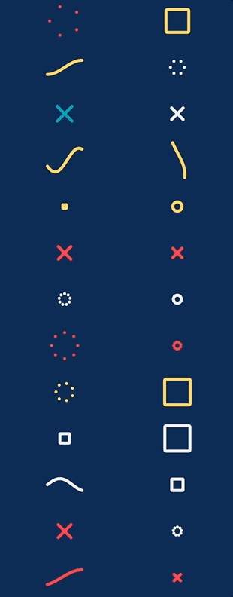
Outline for today
Explain a few popular network reconstruction algorithms
Show some interesting applications in cancer
What are some shortcomings of network analysis?
Talk about executable models of signaling
Show some cutting-edge methods for modeling cancer

Slide 3
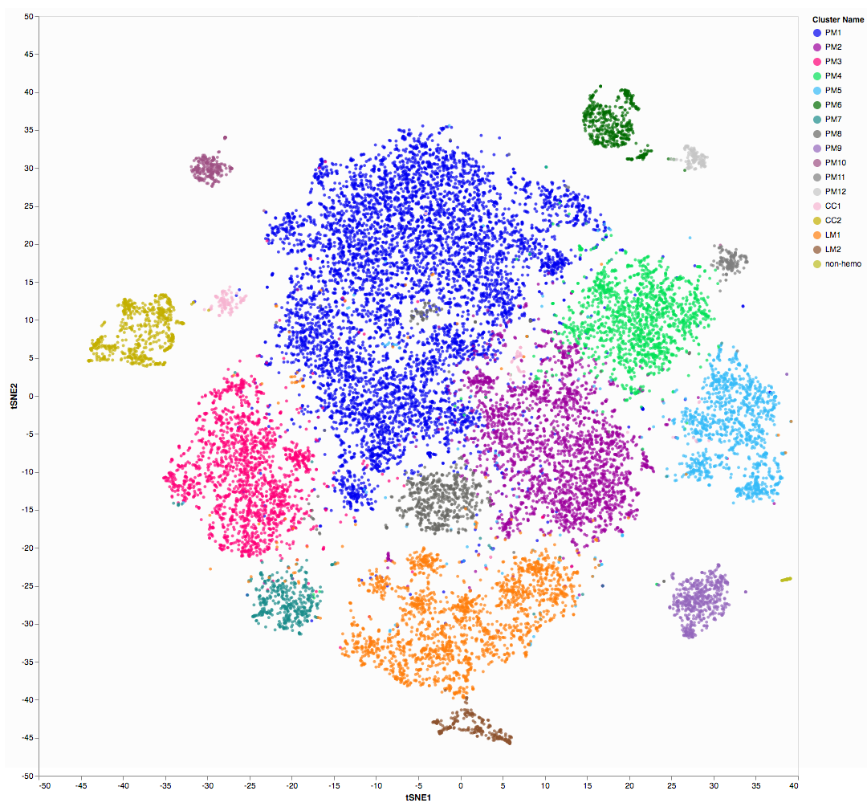
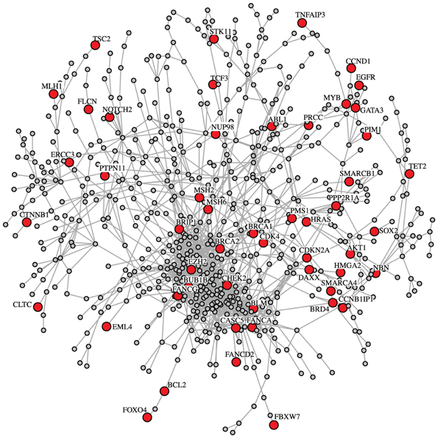
Network Reconstruction
Given measurements of biomolecules
Can we infer how the biomolecules interact with each other?
Why do we care?
How might we do this?

Slide 4
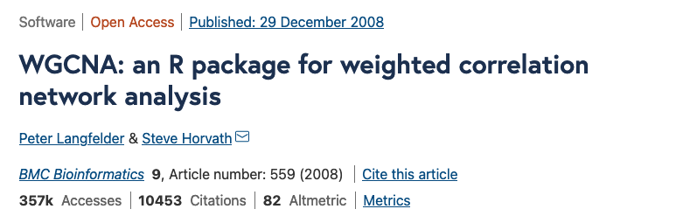
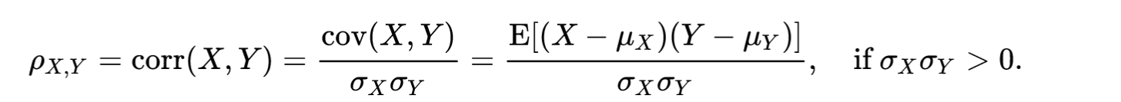
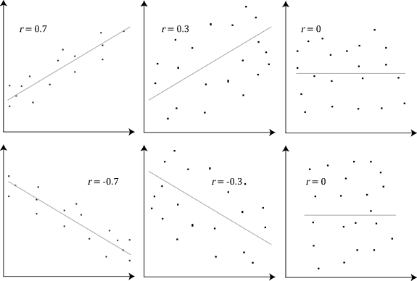
WGCNA = Weighted Gene Correlation Network Analysis
Step 1 – Calculate correlation between all pairs of genes
Correlation -
E[(…)] = mean
σ = variance
𝜇 = mean

Slide 5
WGCNA
Step 2 – Define the network
For every correlation between two genes
Check if the correlation is above a threshold
If yes, then add an edge in the network between the genes
Example, threshold = .9
A, B = -0.01
B, C = -0.98
A, C = 0.91
A
threshold
B
C

Slide 6
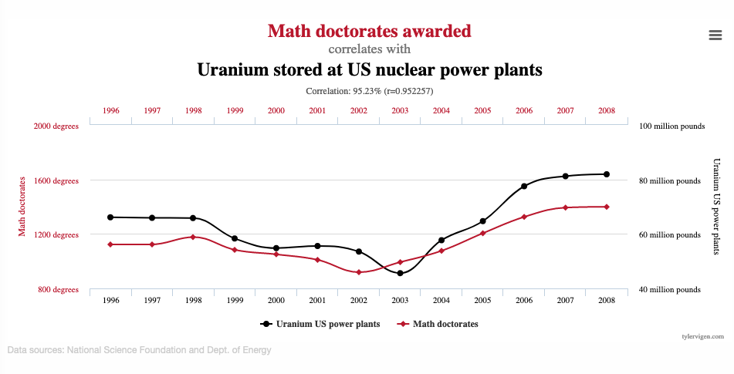
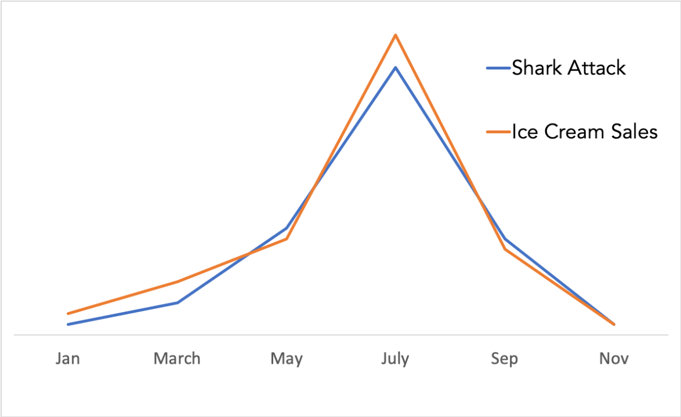
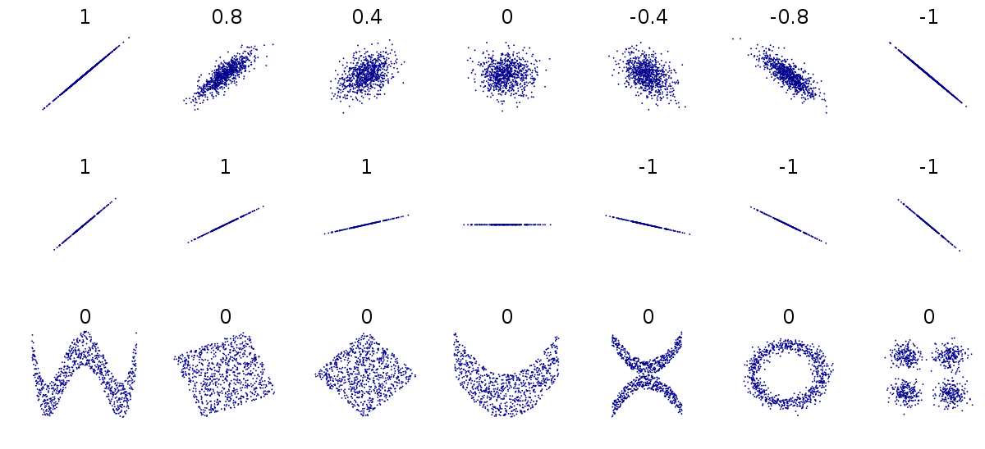

Slide 7
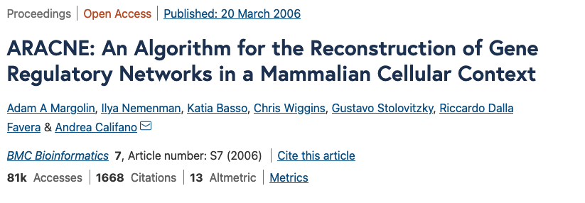
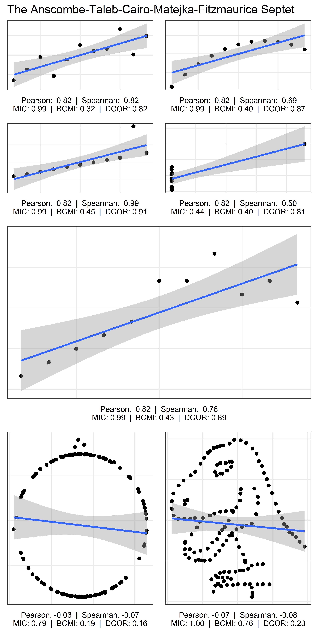
Mutual Information – I(x,y) = H(x) + H(y) – H(x,y)
H(x) = entropy = Σ p(x)log(x)
I know one variable, how surprising is the other?
Compute mutual information for all pairs
Scramble the data, recompute mutual information
This gives threshold for significance
https://mattiheino.com/2019/05/10/correlation/

Slide 8
ARACNE – Data Processing Inequality
Confounders still problematic!
Data Processing Inequality (DPI)
I(A,B) < min[I(A,C), I(B,C)]
if A and B are connected via C
Check all triangles, remove edges that don’t pass DPI
A
C
B

Slide 9
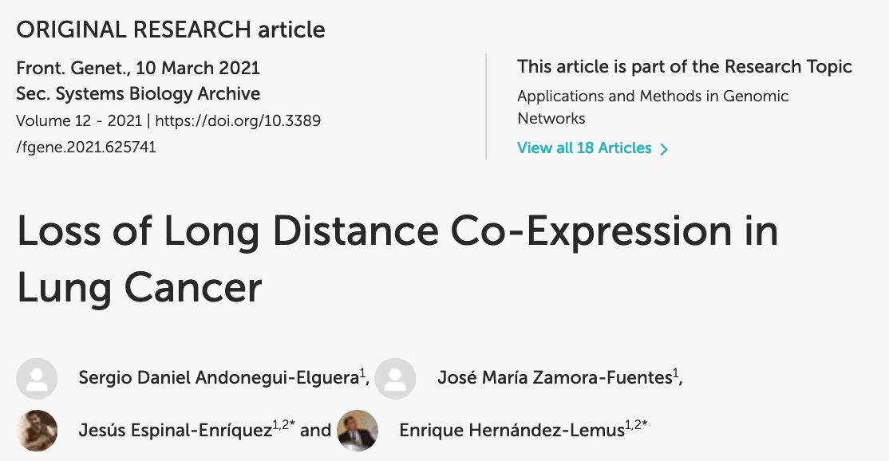
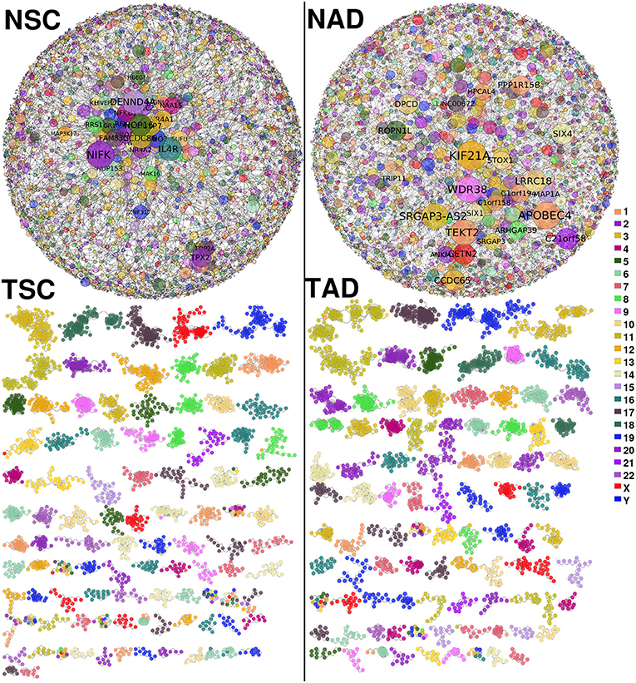
How does co-expression network change between healthy and cancerous tissue?
Applied ARACNe to database of cancer gene expression data, subset to lung cancer
Genomic Data Commons database https://portal.gdc.cancer.gov/
“In the tumor [networks], components are formed mostly by genes from the same chromosome”
Tumor networks are constrained to only interactions on the same chromosome and karyotype band
https://www.frontiersin.org/articles/10.3389/fgene.2021.625741/full

Slide 10
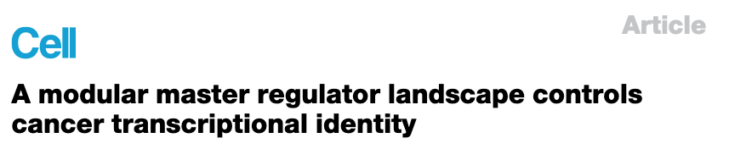
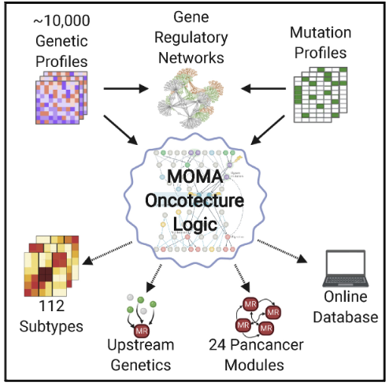
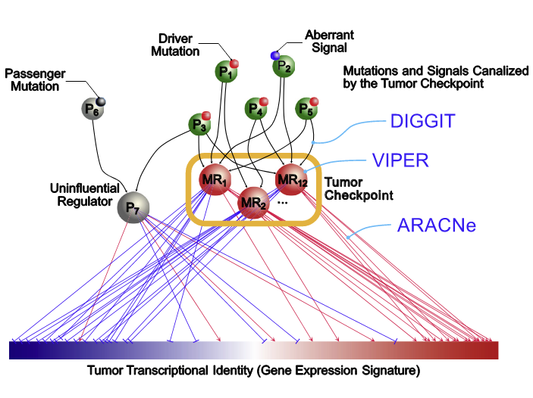
https://doi.org/10.1016/j.cell.2020.11.045
Apply ARACNe to subtype samples from TCGA
Label transcription factor genes using Gene Ontology
VIPER - infer the activity of the transcription factors from expression of their “targets”.
Look “upstream” of the transcription factors to identify genetic variants that alter the activity of transcription factors.
DIGGIT algorithm, comprised of the MARINA, MINDY, and aQTL algorithms

Slide 11
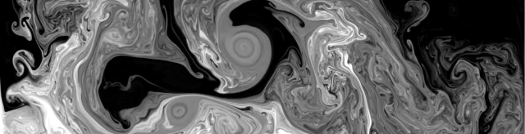
Questions?

Slide 12
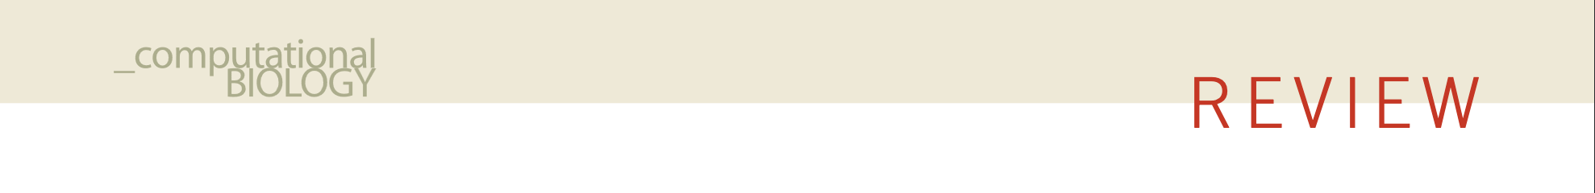

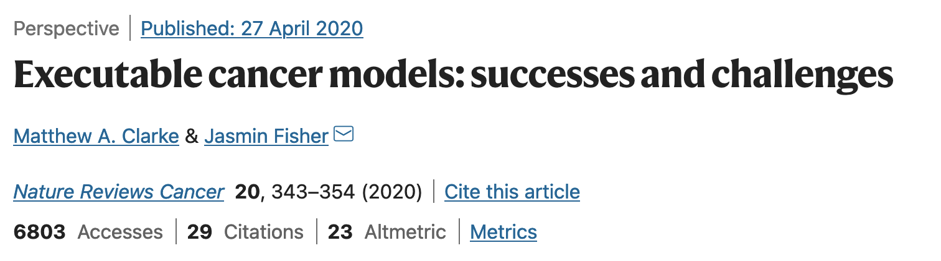
Executable model
Nodes
States associated with nodes
Interactions
Rules associated with those interactions
Simulate/execute to observe state changes according to interaction rules
Discrete, qualitative, multiscale
doi:10.1038/nbt1356

Slide 13
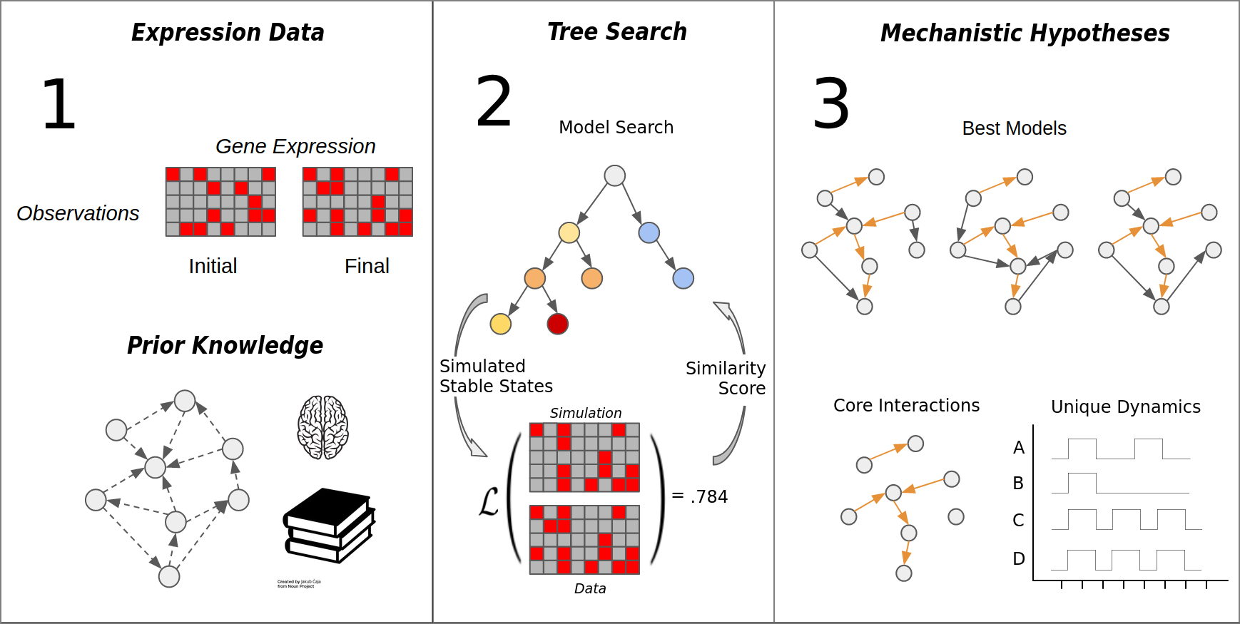
MC-Boomer Workflow

Slide 14
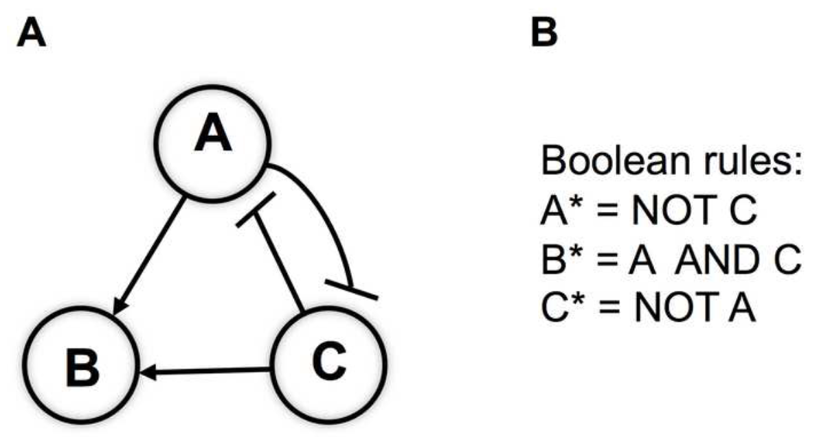
Boolean Models
Simple model of molecular interactions
Each species (molecule) is on (1) or off (0)
Boolean logic update rule determines next state
Eventually reaches stable/cyclic attractor
No parameters - easy to build
Notes:
Maybe drop the gif?

Slide 15
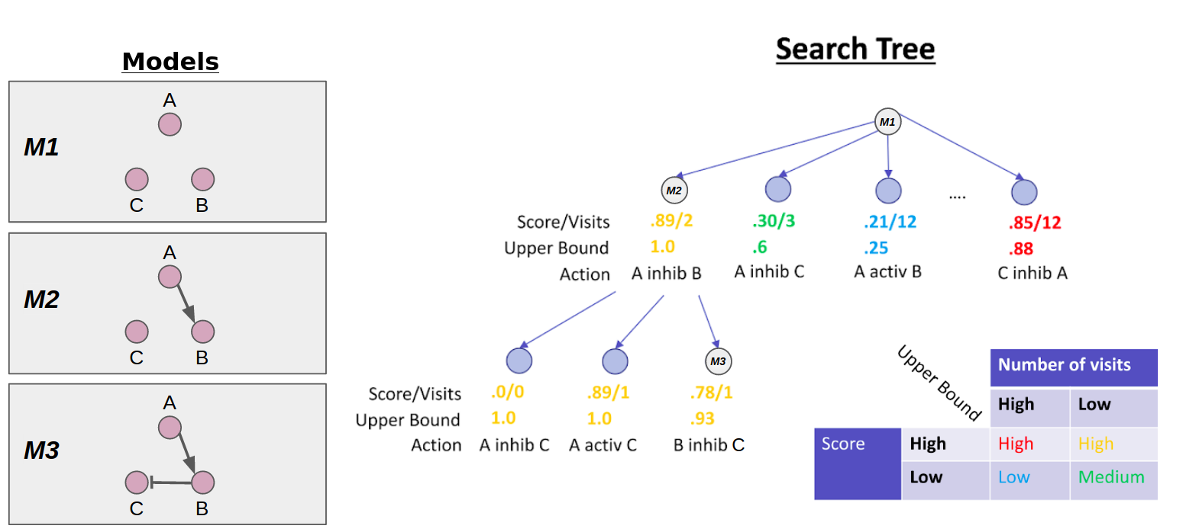
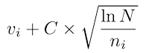
Monte Carlo Tree Search
UCB =
v_{i} = avg score
n_{i} = visits
Model creation as a one player game
Each “move” adds interaction to model’s update rules and branch to search tree
Upper Confidence Bound (UCB) balances exploration vs exploitation

Slide 16
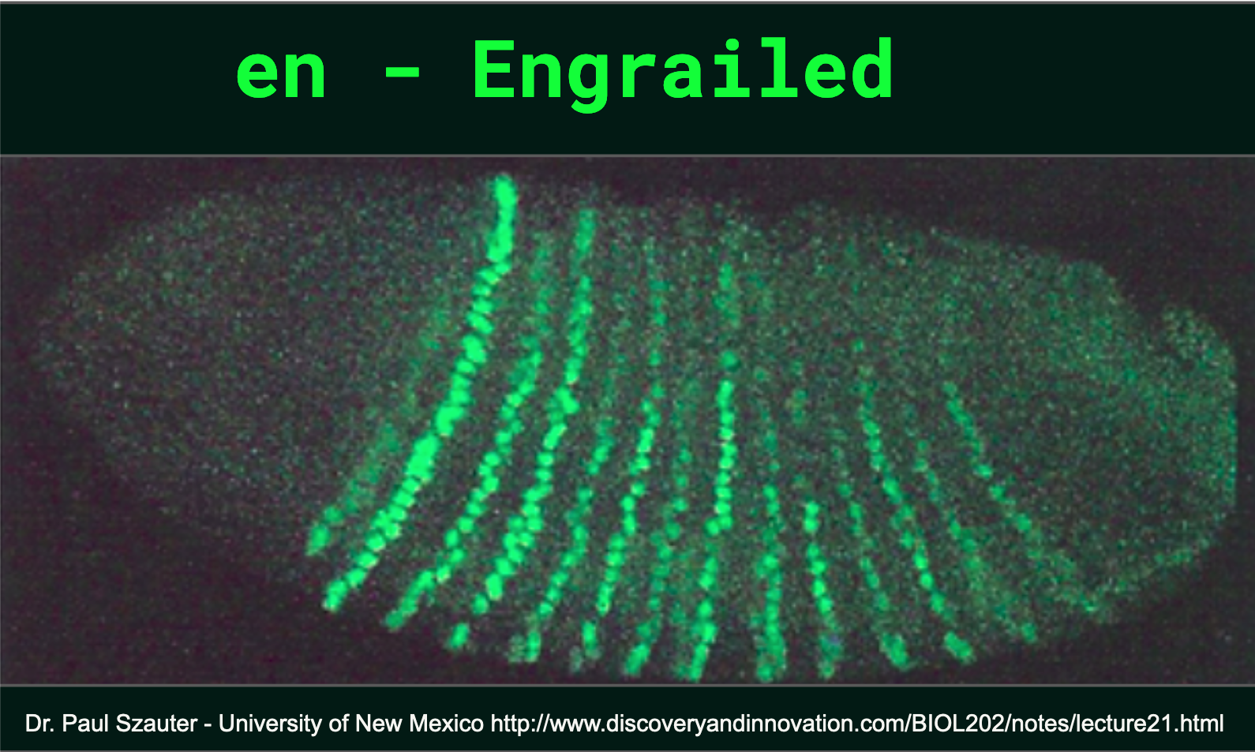
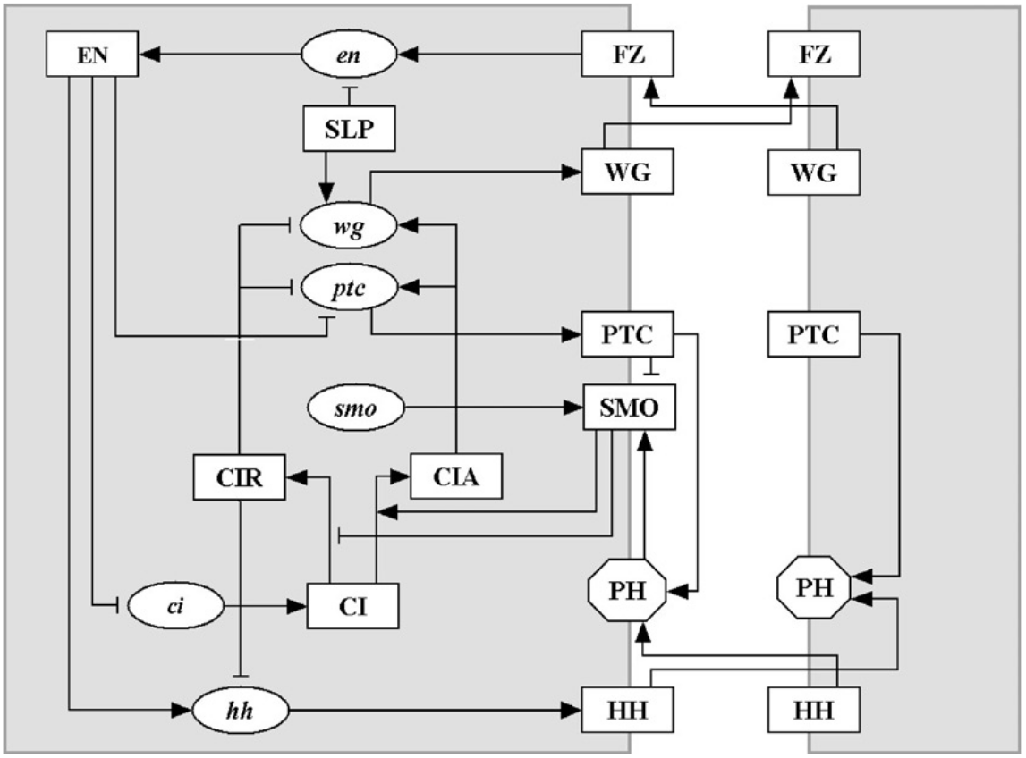
MC-Boomer for the Segment Polarity Network (SPN)
SPN - key developmental circuit in drosophila, controls body segment borders and polarity
Multi-cellular model with multiple experimental conditions
Can MC-Boomer find models with same behavior/structure as hand-crafted model?
Albert and Othmer, J Theor. Biol., 2003, https://doi.org/10.1016/s0022-5193(03)00035-3
Notes:
make sure to mention Reka and Hans

Slide 17
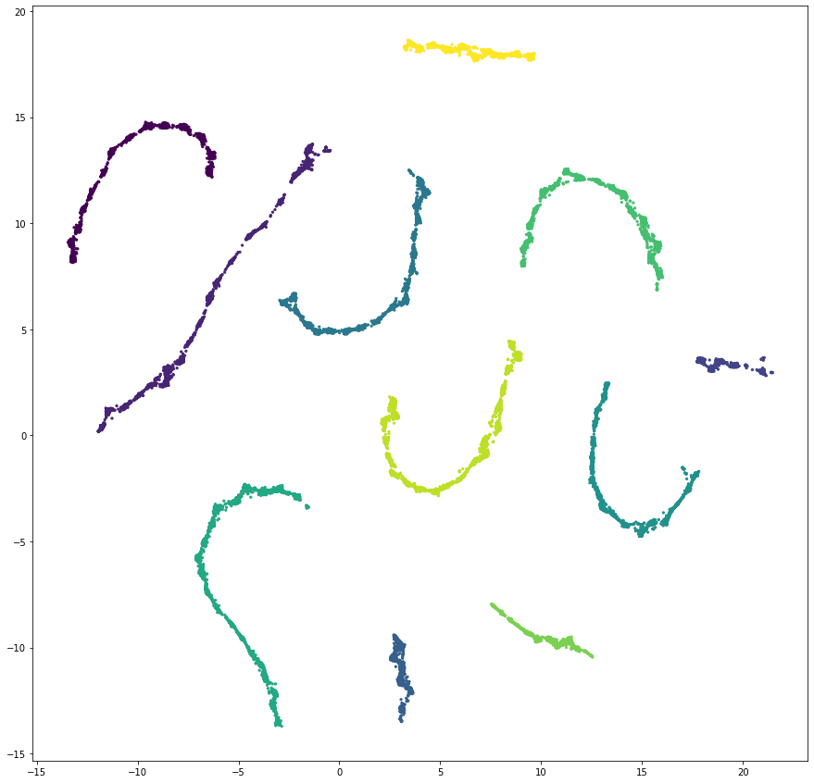
MC-Boomer gener
MC-Boomer generated >200k models with correct behavior
Found models with 11/15 interactions in reference
Computed distances between models
Jaccard similarity on interaction sets
Reduced dimensionality with UMAP, clustered with DBSCAN
Identified 11 model clusters
Computed motif prevalence across all clusters, identified motifs unique to a single cluster
Model clusters - UMAP projection
Notes:
a-b together, c below

Slide 18
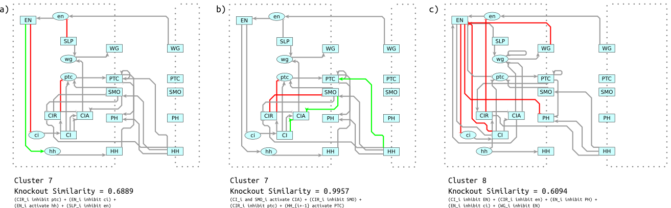
Motif Analysis of Segment Polarity Network
Identify motifs, knock them out, resimulate, compare behavior to original
Motifs from cluster 7
Left - controls system behavior
Right - does not affect behavior
Motif from cluster 8
Highlights mechanism distinct from cluster 7

Slide 19
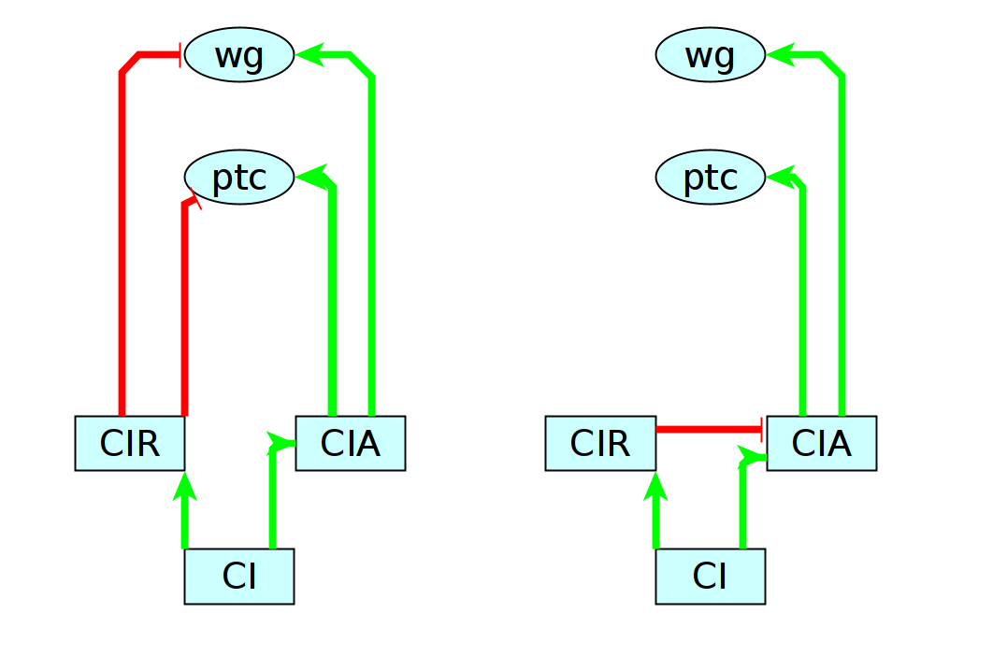
An alternative hypothesis for Cubitus Interruptus
Reference
MC-Boomer
CI = cubitus interruptus
Has an activating CIA and inhibiting CIR form
CIR is a cleaved form of CI
Maybe CIR cleavage inactivates CIA?
Same behavior, different mechanism

Slide 20
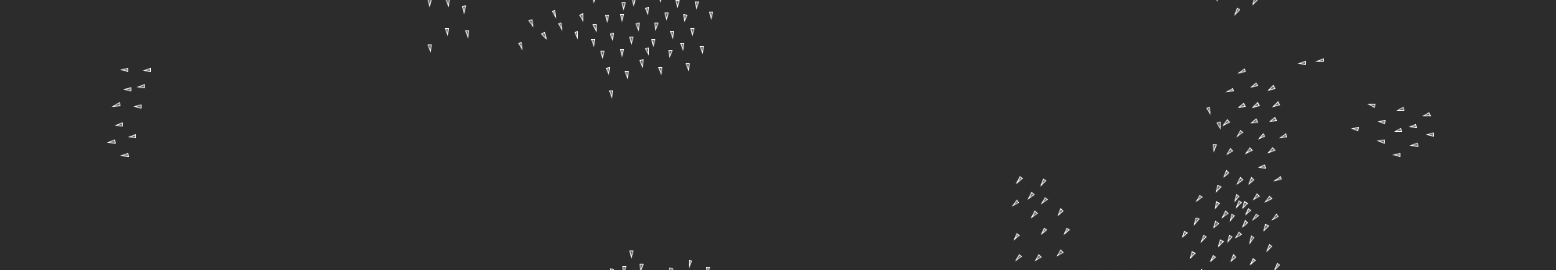
Brief pause for questions

Slide 21
Cutting edge methods for ODE modeling
ODE Modeling has three (broad) phases
Construction
Parameterization
Simulation/analysis
Each of these phases can by assisted by machine learning

Slide 22
Large Language Models
Are the robots going to take my job?
I honestly don’t know
So, let’s try out ChatGPT for a couple tasks
Extracting structured data from natural language
Writing the equations of a model
Explaining the equations of a model

Slide 23
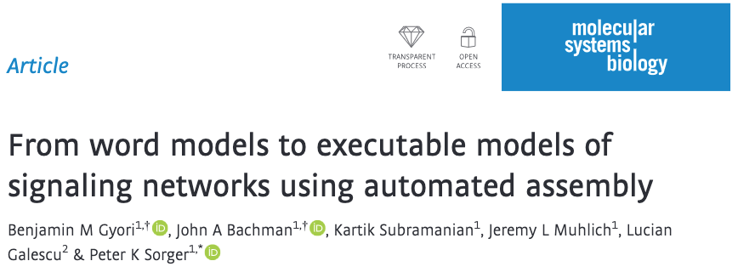
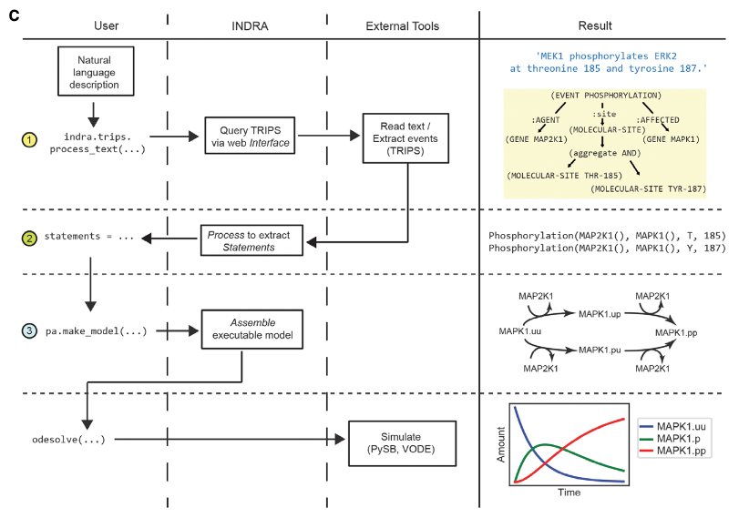
INDRA assembles models from natural language
Scrape descriptions of molecular interactions from literature
Parse into structured format
Convert to “rules”
Build ODE model from rules

Slide 24
AlphaFold for systems biology
We now have models (of varying accuracy) for all human proteins
What can we do with that?
“Structural Systems Biology”
Protein-protein/ligand interactions across whole proteome?
Kinetics of interactions?
In-silico mutational scanning?
Yes, maybe.

Slide 25
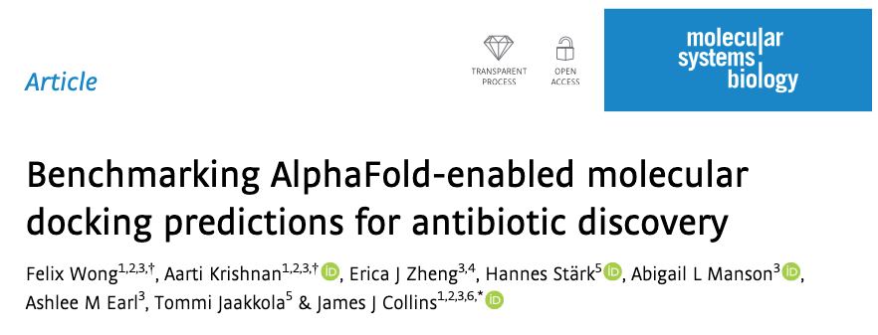
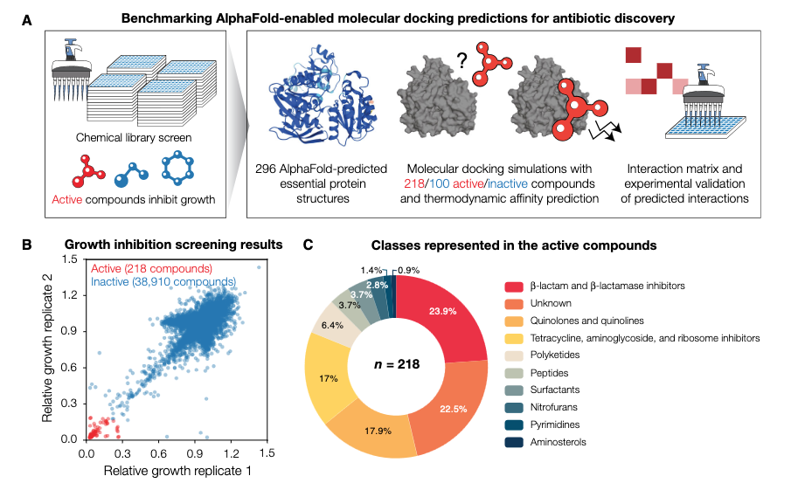
Can we predict binding energy with AlphaFold structures?
No, not yet
“We found that this approach predicts widespread promiscuity”
In vitro enzymatic activity for 12 proteins supported promiscuity, … this approach has weak predictive power in identifying true protein-ligand interaction

Slide 26
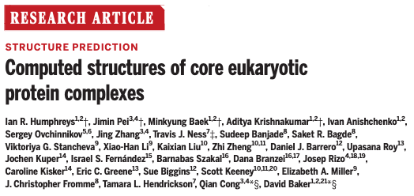
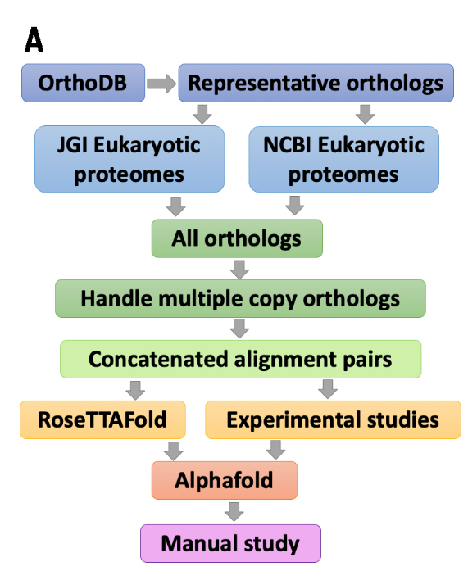
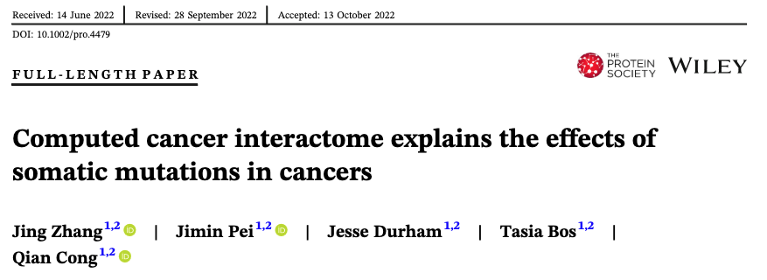
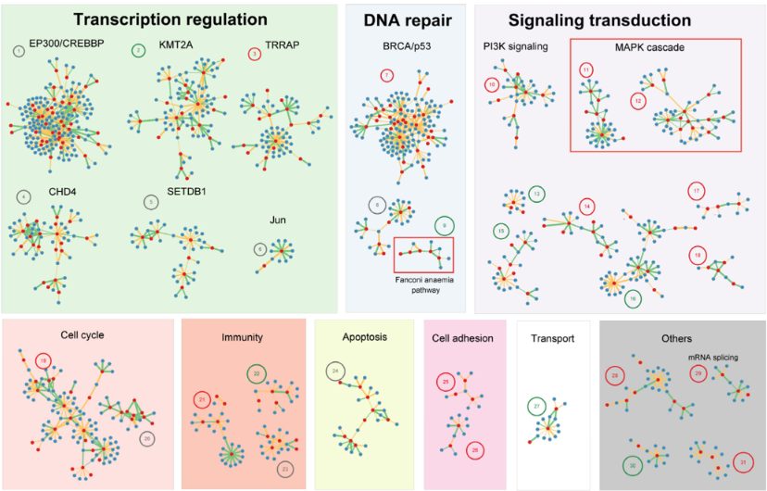
AlphaFold can learn which proteins form complexes
Assemble known protein complexes
Run RoseTTAFold+AlphaFold with paired sequences
Then apply to all proteins with cancer-associated mutations
Identify binding surfaces and mutations in those residues
What affect does binding mutation have on phenotype?

